Slide 1
Welcome!
Overview of ISO Location Codes
This file is set to be viewed in presentation mode.
Version: 5 April 2026

Slide 2
ISO Location Codes
Notes:
Códigos de ubicación ISO
Ejemplo : LT5N =
L = lado izquierdo ( left )
T = parte de arriba ( top )
5N = panel numero 5

Slide 3
ISO/CEDEX 9897
Container Equipment Data Exchange
A combination of 4 alpha & numeric codes.
1st Character identifies the face of the container.
Right Side | R
Left Side | L
Roof / Top | T
Bottom / Floor | B
Front End (opposite of Door side) | F
Door End | D
Understructure | U
Whole Container | X
Container Interior | I
Container Exterior | E

Slide 4
ISO/CEDEX 9897
Container Equipment Data Exchange
A combination of 4 alpha & numeric codes.
2nd Character identifies the horizontal seperation
High – Upper Component | H
Top – Top Half | T
Bottom – Bottom Half | B
Ground – Lower Component | G
Both Halves; or all 4 horizontal zones | X (H, T, B, G)
Neutral, no further character needed | N (can only be used as 4th character code)
Specific for ROOF | BOTTOM | UNDERSTRUCTURE
Right Half | R | No separation in right or left half for the INTERNAL or EXTERNAL section. This is either IXXX or EXXX.
Left Half | L
Both Halves | X
“X” if damage covers the entire length of the container face, use “X” as the 3rd and 4th character codes

Slide 5
ISO/CEDEX 9897
Container Equipment Data Exchange
A combination of 4 alpha & numeric codes.
3rd + 4th Character identifies the vertical separation
20ft containers | 5 sections long
40ft containers | 10 sections long (e.g. RB48, LT80
Section 10 is represented via the figure 0 → 1 | 2 | 3 | 4 | 5 | 6 | 7 | 8 | 9 | 0
Damage across the full length | X → instead RB10, it would be RBXX

Slide 6
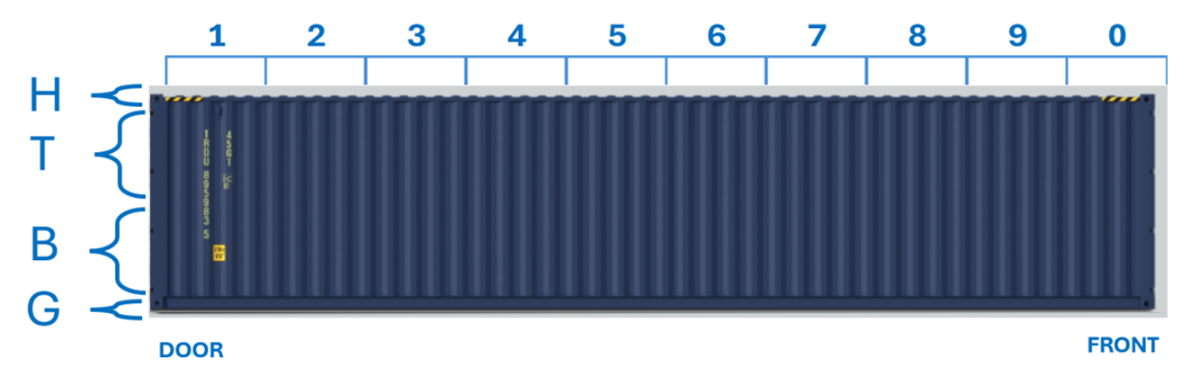
ISO/CEDEX 9897
Container Equipment Data Exchange
Horizontal Position – Count always starts at the door end side.
X
Right Side

Slide 7
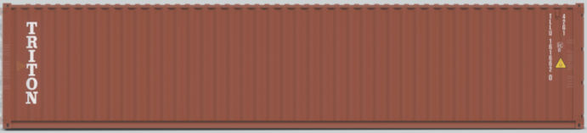
H
T
X
B
G
FRONT
DOOR
Left Side

Slide 8
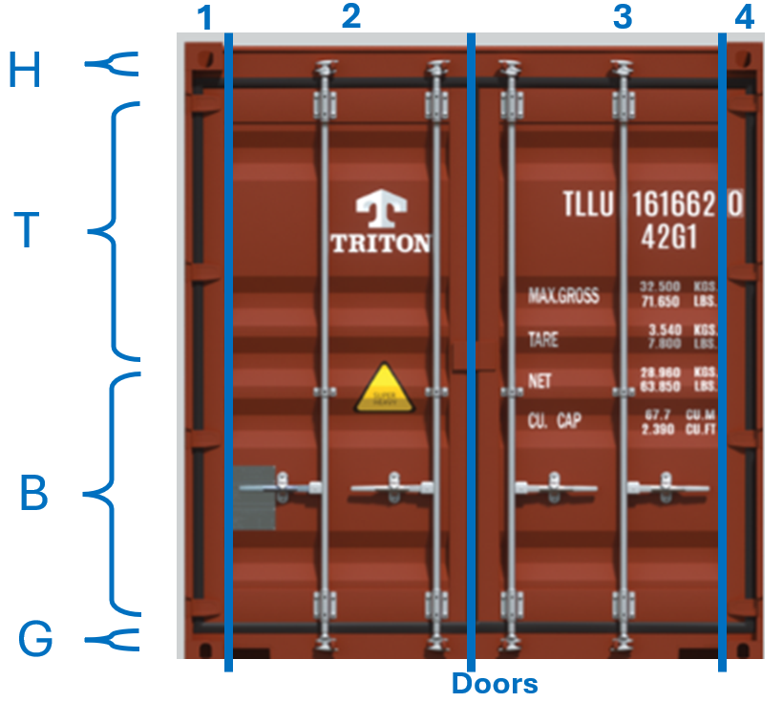
ISO/CEDEX 9897
Container Equipment Data Exchange
Vertical position.
H > HIGH
T > TOP
B > BOTTOM
G > GROUND

Slide 9
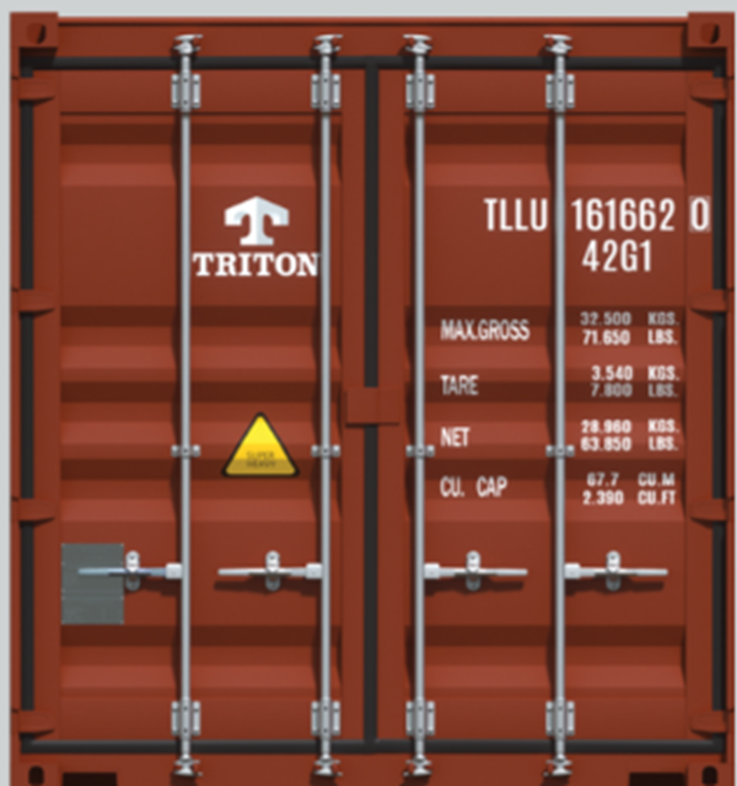
1
2
3
4
H
T
X
B
G
Doors

Slide 10
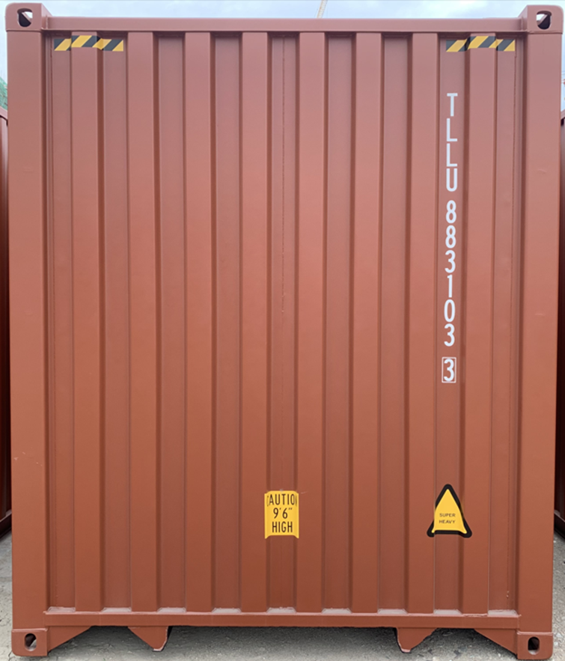
4
3
2
1
H
Follows the door positions
T
X
B
G
Front

Slide 11
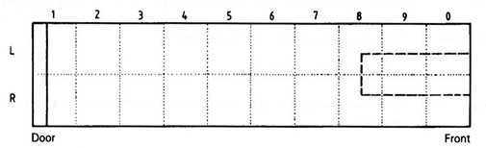
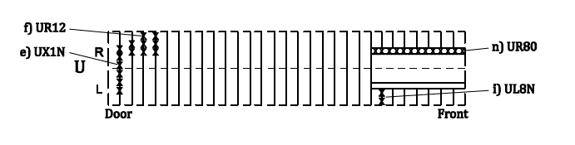
Floor Face = B (first character)
Underside = U (first character)

Slide 12

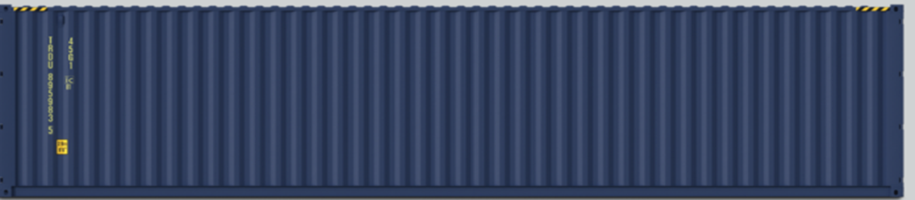

RB23
RX0N
RT2N
RG6N
Right Side

Slide 13
1
2
3
4
H
DH2N
T
X
B
DB1N
G
Doors

Slide 14
4
3
2
1
H
Follows the door positions
T
X
FB3N
B
G
Front

Slide 15
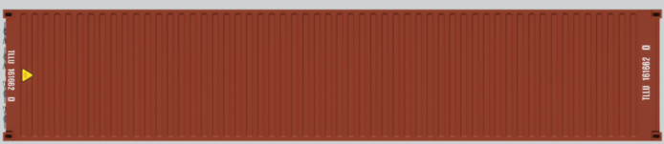
TL3N
Roof = T
Doors
TX9N

Slide 16
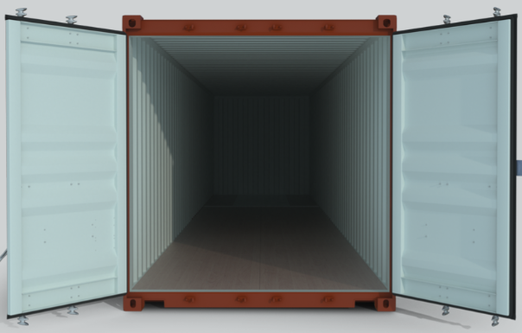
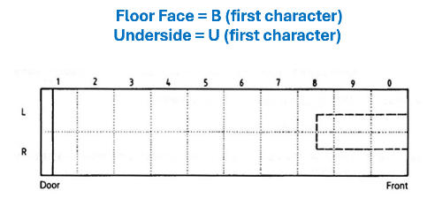
IXXX
BL1N

Slide 17
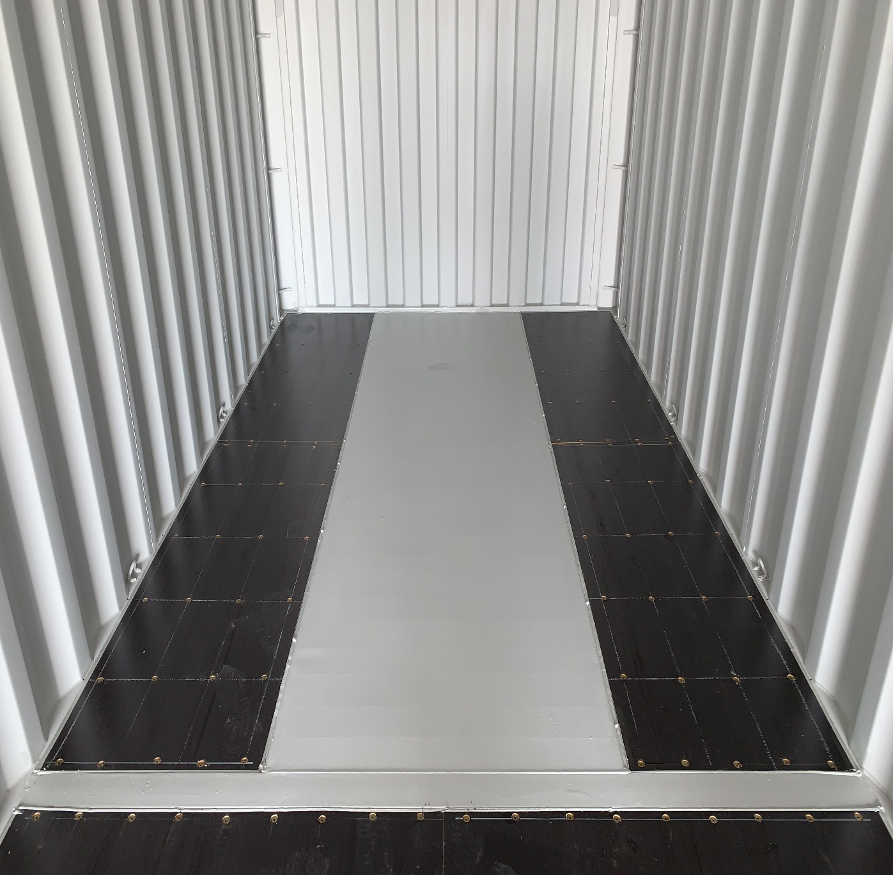
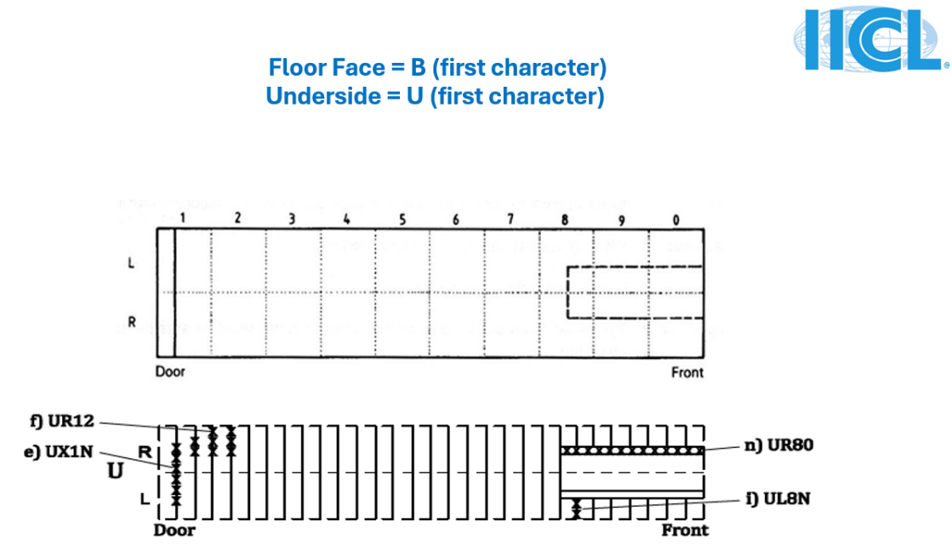

BL0N
BR80

Slide 18


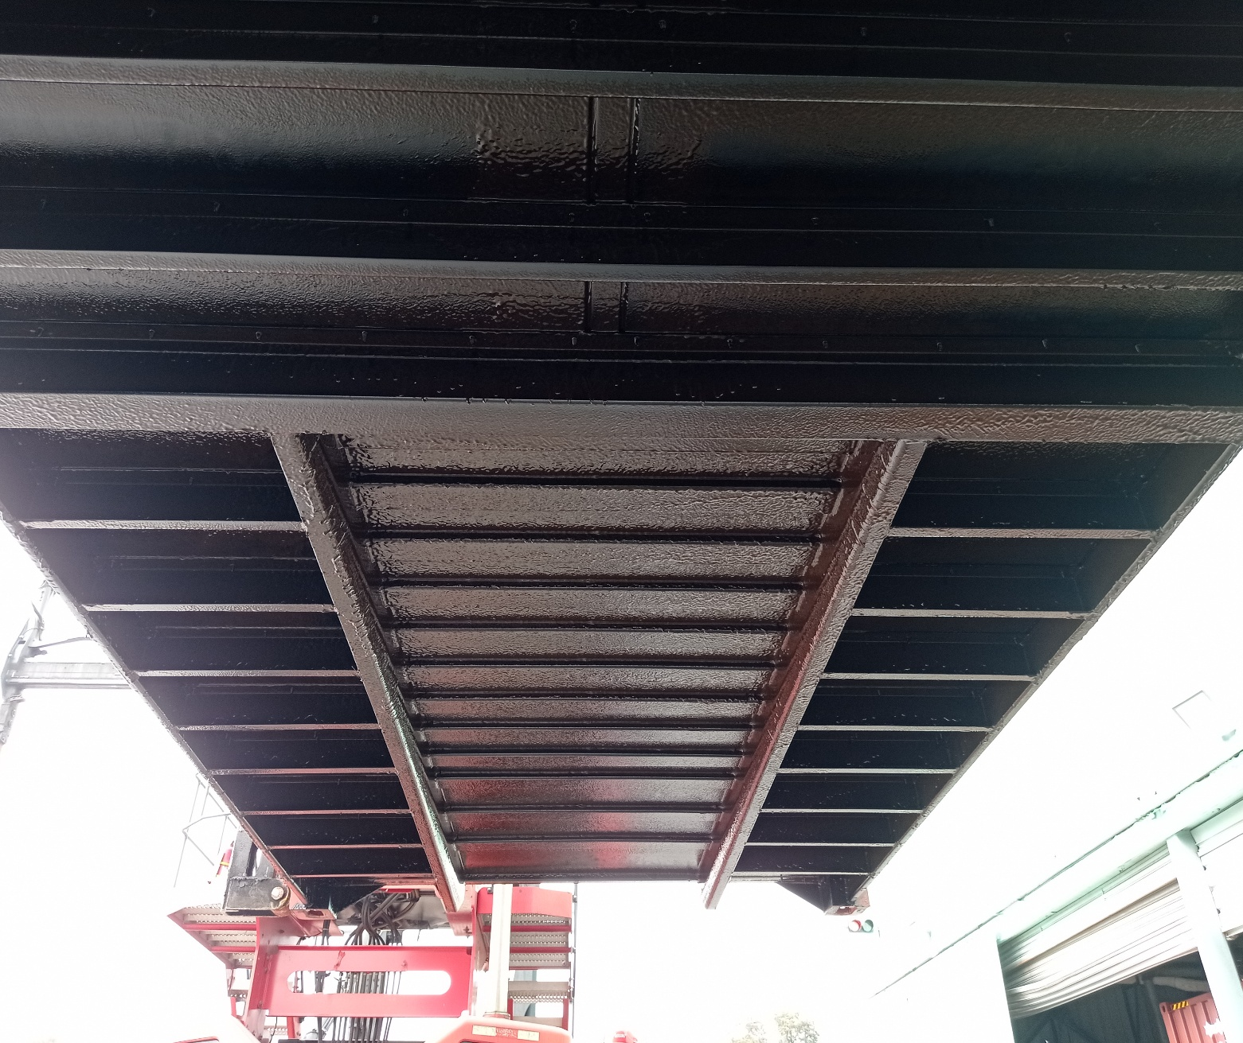

UX8N
UR8N
Left
Side
Right
Side
UL9N

Slide 19

Thanks for watching it. We hope this presentation was useful to you.
If you have questions or suggestions, please contact: technical@iicl.org
Setting Industry Standards for 55 Years.

